Slide 1
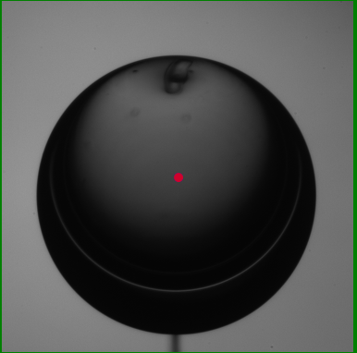
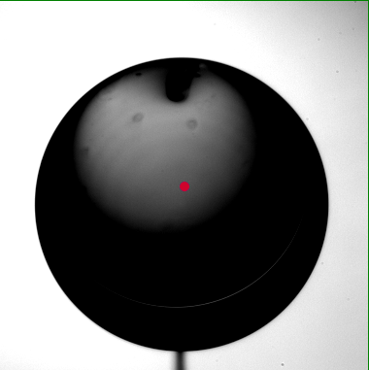
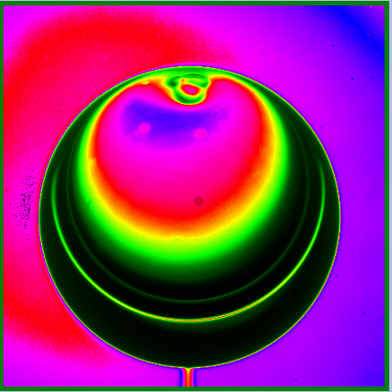
Image Manipulation
From Image Scaling to Palettes to Display
Larry O’Heron

Slide 2
Overview
Gray Scaling
Palettes
Displaying Image
Centering the Target

Slide 3
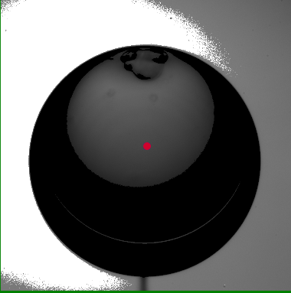
Gray Scaling

Slide 4
Gray Scaling Overview
Justification
Histogram Equalization
Histogram Equalization Algorithm
The Algorithm

Slide 5
Justification
Definition – method of image processing by contrast adjustment
Purpose – increases contrast of images, especially when the usable data of the image is represented by close contrast values
Run demo code for scaling.
  Show four kinds of equalization
    None
    Static
    Expanded
    Automatic

Slide 6
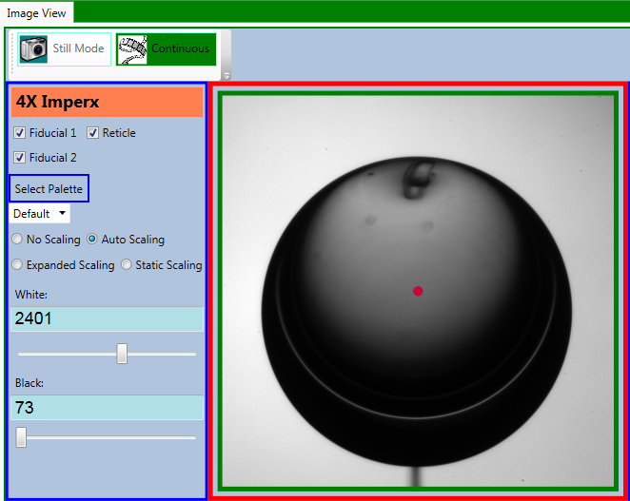
The User Interface

Slide 7
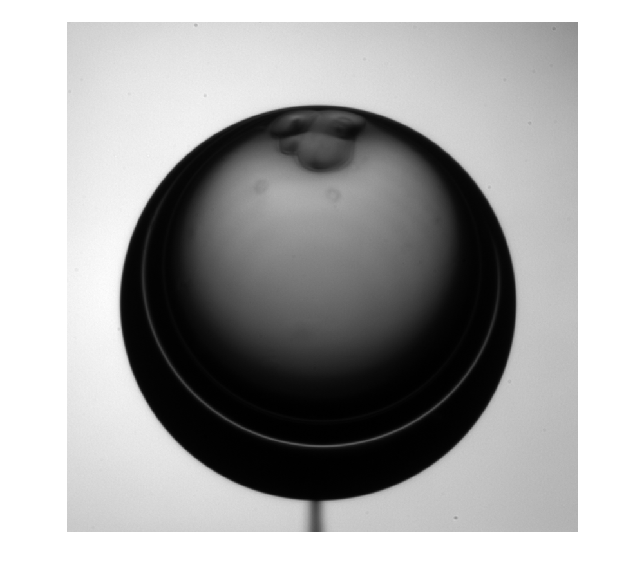
The Target
750 µ cryogenic target at 15K
Field of View ≈ 1200 µ (1.2mm )
f1 = figure; figure (f1);
rawData = hdfread( ‘SimulationData.hdf’, ‘Image 1’);
target = rawData;
imgTarget = mat2gray( rawData);
imshow(imgTarget);

Slide 8
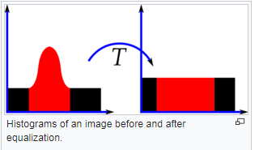
Histogram Equalization
Result – the intensities are better distributed on the histogram
Action – spreads out the most frequent intensity values
Manipulation – often produces unrealistic effects; useful for scientific images.

Slide 9
Types of Equalization
None – original images is unchanged
Static – predefined lower/upper threshold with no manipulation in between
  if pixel value < lower threshold, pixel = 0
    else if pixel value > upper threshold, pixel = max val
    else pixel value is unchanged
Expanded - predefined lower/upper threshold with sliding scale in between
  if pixel value < lower threshold, pixel = 0
    else if pixel value > upper threshold, pixel = max val
    else pixel value = mx + b between 0 and max val
Automatic
  lower threshold = min pixel val in image
  upper threshold = max pixel val in image
  pixel value = mx + b between 0 and max val

Slide 10
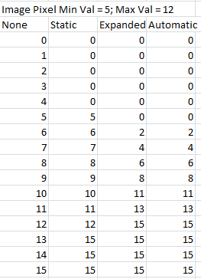
Histogram Equalization Algorithm
Create a Scale
None – no image manipulation
Static – removes edge case info
  Lower/upper threshold
Expanded – spreads out pixel vals for
  values of interest
  Fixed lower/upper threshold
Automatic – spreads out pixel vals
for values of interest
    Dynamic lower/upper threshold

Slide 11
The Algorithm
/// The image data is 12-bit.
AdjustImageForGrayScaling (Array image, int width, int height)
ConvertToUnsignedImageData(Array image, Array workingImage)
Create12BitMapForGrayScale(Array mapScale, choice)
CreateImageWithGrayScale(Array workingImage, mapScale)

Slide 12
Convert Signed Image Data to Unsigned Data
ConvertToUnsignedImageData(Array image, Array workingImage)
{
if (image.GetType() == typeof ( UInt16[ ] ) )
Array.Copy(image, workingImage, width * height);
else if (image.GetType() == typeof( Int16[ ]) )
for (int i = 0; i < image.Length; i++)
{// deal w/ background subtraction negative numbers }
Array.Copy(image, workingImage, width * height);
// Why are we making a copy of potentially a large array?
// What about datatype Byte and SByte?

Slide 13
Create the Map for Scaling
Create12BitMapForGrayScale(Array mapScale, ScalingChoice choice)
{ // creating the scale here; not processing image
switch (choice)
NoScaling:
for (int i = 0; i < m_mapScale.Length; i++) mapScale[i] = i
Static:
for (int i = 0; i < mapScale.Length; i++)
if (i < blackLvl) mapScale[i] = 0
else if (i > whiteLvl) mapScale[i] =maxPixelVal }
else { mapScale[i] = i; }
Expanded:
Auto:
}

Slide 14
Create the Map for Scaling
Create12BitMapForGrayScale(ref Array mapScale, ScalingChoice choice)
{
switch (choice)
NoScaling:
Static:
Expanded, Auto: // left out err checks for maxVal = no light,
// minVal = fully saturated, minVal = maxVal (div by 0)
for (int i = 0; i < mapScale.Length; i++)
if (i < minVal) mapScale[i] = 0
else if (i > maxVal) { mapScale[i] = maxVal
else
int numerator = ( maxPixelVal * (i - minVal) );
int denominator = maxVal - minVal;
mapScale[ i ] = (short)(numerator / denominator);
}

Slide 15
CreateImageWithScale
CreateImageWithGrayScale(Array workingImage, mapScale)
{
for (int i = 0; i < workingImage.Length; i++)
// compensate for static/expanded/auto scaling
pixelVal = workingImage[i]
scaledVal = mapScale[pixelVal]
workingImage[ i ] = scaledVal
/* or in a one-liner
workingImage [ i ] = mapScale[ workingImage [ i ] ]
*/
}
We have applied gray scaling but not color palette, so not ready for display on monitor.

Slide 16
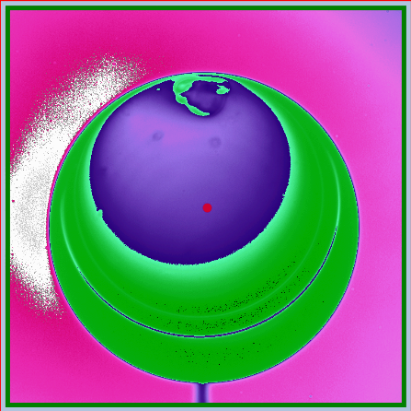
Applying the Color Palette

Slide 17
Overview
Definition
Palettes
Palette Algorithm
Sample Palette
The Algorithm
Run demo code for palettes.

Slide 18
Color Palette
Purpose: maps (transforms) the colors of one (source) image to a different representation as the colors of another (target) image
Definition: the data and algorithm that transforms the image colors.

Slide 19
Color Palette Demo
Default, Tropical and Volcano palettes
Demo palettes in combination with scaling.
Sample Code

Slide 20
Palette Algorithm
Create a Palette
  For each possible pixel value
    Assign color representation (Red, Green, Blue)
Apply the Palette
  For each pixel in the image
    Get the pixel value
    Assign the color representation
Show Volcano color palette.
Show code to load all palettes.

Slide 21
Sample Palette
Grey Palette for display on a monitor
  Pixel Value 0 = Red 0, Green 0, Blue 0
  Pixel Value 128 = Red 128, Green 128, Blue 128
  Pixel Value 255 = Red 255, Green 255, Blue 255
Highlight High Pixel Count Palette
  Pixel Value 0 = Red 0, Green 0, Blue 0
  Pixel Value 128 = Red 64, Green 64, Blue 64
  Pixel Value 192 = Red 128, Green 128, Blue 128
  Pixel Value 255 = Red 255, Green 255, Blue 255
Demo: Open Volcano palette in Excel
How does a digital camera record an analog image?
Why choose a camera with a range of pixel values from 0 to 4095?
Why does the palette only have 255 rows for transformation?

Slide 22
24-Bit Color in an 8-Bit System
There are two definitions with two different meanings.
RGB color has three channels.
8-bit system means each Red, Green, and Blue channel is 8-bits
(24 bits across three channels).
The 8-bits means 256 values or shades, values 0..255 (2⁸ = 256) of Red.
The 8-bits means 256 values or shades, values 0..255 (2⁸ = 256) of Green.
The 8-bits means 256 values or shades, values 0..255 (2⁸ = 256) of Blue.
This can create 256 x 256 x 256 = 16.77 million possible color combinations, called 24-bit color.
Today, the vast extreme majority of our monitors, video cards and printers are 8 bit devices, meaning 24-bit color, meaning they can show 16.77 million colors.
The eye CAN NOT discern those individual 16.77 million colors.
Not discussing the Alpha channel (see-thru) in this presentation.
Note the distinction between 8-bit channels and 8-bit image data.

Slide 23
The Algorithm
/// The image data is 12-bit.
AdjustImageForDisplay (Array image, int width, int height)
ConvertToUnsignedImageData(Array image, Array workingImage)
Create12BitMapForGrayScale(Array mapPalette, PaletteScale choice)
CreateImageWithGrayScale(Array workingImage, mapPalette)
ShiftTo8BitsForMonitorDisplay(workingImage, displayImage)
Convert8BitGrayTo24BitRGB(displayImage, listPalettes, ndxPalette, 3, palettizedImage) // color enters here. All before is gray scale.
DisplayPalettizedImage()

Slide 24
Monitors Only Use 8 Bits to Display an Image
ShiftTo8BitsForMonitorDisplay(Array workingImage, Array displayImage)
{ // workingImage is ushort[ ]; displayImage is ubyte [ ]
for (int i = 0; i < workingImage.Length; i++)
// have now right shifted a 12-bit pixel format into 8-bits
displayImage[ i ] = (byte) (workingImage[ i ] >> 4);
}
/// The image data is 16-bit.
/// The flat panel monitor can only display 8-bit data.
/// To minimize data loss, shift pixel data right
/// by 4-bits. Then, e.g. 00001101 00111101 becomes 0000000 11010011
/// (3389 -> 211 ) (0x0D3D -> 0xD3).
Note: You could shift left 4 bits to create 16-bit gray scale value (ushort) and then later use PixelFormats.Gray16 if creating the a gray scale bitmap, instead of a colorized bitmap.

Slide 25
Convert From Gray Scale to RGB Image
Convert8BitGrayTo24BitRGB
(displayImage, listPalettes, ndxPalette, stride, palettizedImage)
{
int index = 0;
for (int i = 0; i < displayImage.Length ; i++)
// 'i' is 8-bit val location. 'index' + n is the 24-bit val location
index = i * pixel_stride; // 8-bit has stride 1; rgb has stride 3
val = displayImage[i];
palettizedImage[index ] = listPalettes[ndxPalette].Colors[val].R;
palettizedImage[index + 1] = listPalettes[ndxPalette].Colors[val].G;
palettizedImage[index + 2] = listPalettes[ndxPalette].Colors[val].B;
// Have read that Windows uses BGR, not RGB.
}

Slide 26
Display Palettized Image On Monitor
DisplayPalettizedImage()
{
bmp = new WriteableBitmap(width, height, 96, 96, PixelFormats.Rgb24, m_listPalettes[ndxPalette]);
System.Windows.Int32Rect rect = new Int32Rect
(0, 0, bmp.PixelWidth, bmp.PixelHeight);
// msdn says width is stride in pixels, but that does not seem to be true.
// Int32Rect, System.Array, stride in pixels, input buffer offset
bmp.WritePixels(rect, palettizedImage, width * 3, 0);
bmp.Freeze(); // Freeze allows update UI if not on the UI thread.
}
// Why would we not manipulate the image on the UI thread?

Slide 27
Summary
Justification for Scaling and Palettes
A histogram a graph of the frequency of occurrence of a pixel value across the x-axis
A palette transforms the colors of a source image to highlight contrast in the source image

Slide 28
Centering

Slide 29
Overview
The System and Issues
Algorithm
Toolsets
Target Rotation Parameters
Binary Conversion
Contours
Validation

Slide 30
Cryogenic Target Processing System
Network
Virtual Computer
GigE
Ntwk
GigE
Netburner
Plc (Registers)
RS232
Illumination Control
Cam
Stage
Motors
Lake shore
Cam
LED
LED

Slide 31
Target Rotation and Image Acquisition
Run demo and illustrate target.
Rotate target about the z-axis.
Iterate the centering operation until successful
  Measure the target center offset from view area center
  Move the target
Acquire image data for processing

Slide 32
The Target
750 µm cryogenic target at 15K
Field of View ≈ 1200 µ (1.2mm)
f1 = figure; figure (f1);
rawData = hdfread( ‘SimulationData.hdf’, ‘Image 1’);
target = rawData;
imgTarget = mat2gray( rawData);
imshow(imgTarget);
Matlab normalizes each pixel value (0 – 4095) to [ 0 .. 1.0 ].

Slide 33
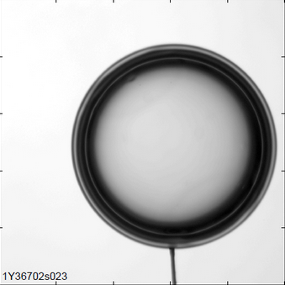
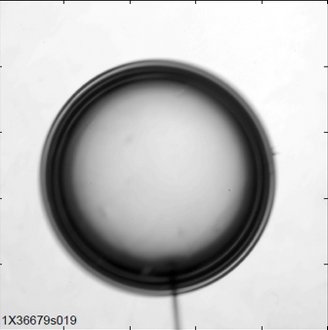
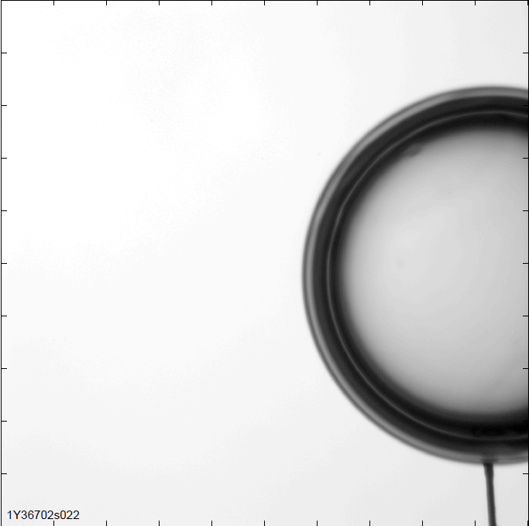
Image Analysis Issues
Focused
High Vibration At Theta
(Solution: Short Exposure Time)
High Runout Transition to Next Theta
(Solution: Intermediate Theta)

Slide 34
Pre-requisites
Real world model
Camera alignment: non-orthogonal; each has angled offset from stage axis
Stage axis motor calibration
Vibration dampening
Illumination
  exposure time
  diode current
Microns/pixel calibration
  Establishes physical height/width of field of view

Slide 35
Algorithm
Collect n images in pairs from both x and y axis cams
Locate target center on each image (Will explore in depth)
If good dataset, continue. (Found center in all images)
Build array of center points for the image pairs
  [ (480, 510), (505, 490), … (485, 500), (495, 505)]
Build array of horizontal / vertical offsets from center for each image
    [ (-20, 10), (5, -10), … (-15, 0), (-5, 5)]
Transform offsets (per image pair) to x, y & z stage move commands
  [ (12, 0, 3), … (7, -3, 2)] * microns per pixel
Find stage move values: Take avg(x), avg(y) and avg(z) * move adj factor
Calculate radial average of stage moves: sqrt( xMove ^2 + yMove ^2)
radial average / microns per pxl < focal tolerance?
  Target is centered

Slide 36
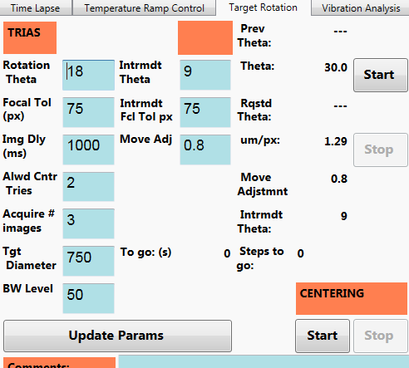
Target Rotation
Theta: angle of rotation of target
Focal Tolerance: max acceptable distance of target center from view screen center
Image Delay: time from one image set to next
Move Adjustment: Prevent overshoot when moving stage axis motor
Allowed Centering Tries: how many times the algorithm will try to center the target. Prevent target damage.
Acquire # Images: how many images are used to calculate stage moves
Target Diameter: calculate area of target
Black/White Level: determines transition point for inverse binary thresholding

Slide 37
Toolsets
Emgu CV processing tools (3rd party library, no source code)
use theImage = CVExt.ImageFromArray(img, scale)
theImage._ThresholdBinaryInv(grayValue threshold,
    grayValue 255)
let contours = theImage._FindContours(
CV_CHAIN_APPROX_NONE,
CV_RETR_EXTERNAL,
roi.Location, MemStor)

Slide 38
Scaling
Purpose: toolsets expect to work with byte data for pixel vals.
Cameras collect 12-bit data for the pixels.
Must scale down before handing off to emgu toolset
For each pixel value
(int) new value = (int) pixel value / (int)16; // same as val = val >> 4
pixel val = 0 (black) / 16 = 0
pixel val = 2048 / 16 = 128
pixel val = 4095 (fully saturated) / 16 = 255
Note: Excel using floating point div and rounds up.
1000 / 16 = 62.5 ➔ 63
(int) 1000 / (int) 16 = 62; 0x3e8 >> 4 = 62 = 0x3E
0 | 1000 | 2000 | 3000 | 4000 | 4095
40 | 1040 | 2040 | 3040 | 4040 | 4095
100 | 1100 | 2100 | 3100 | 4050 | 4095
0 | 63 | 125 | 188 | 250 | 255
3 | 65 | 128 | 190 | 253 | 255
6 | 69 | 131 | 194 | 253 | 255

Slide 39
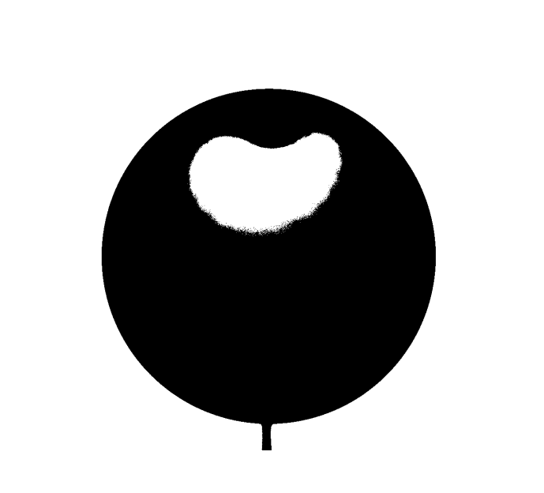
Threshold Binary Display
We have clearly defined boundaries in the image at the pixel value(s) of interest.
f1 = figure; figure (f1);
rawData = hdfread(‘SimulationData.hdf’, ‘Image 1’);
target = rawData;
target(target<1201)=0;
target(target>1200)=255;
imgTarget = mat2gray(target);
imshow(imgTarget);

Slide 40

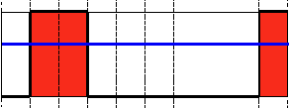
Algorithm: Binary Threshold
If the intensity of the pixel is higher than threshold, then the new pixel intensity is set to max value . Otherwise, the pixels are set to 0.

Slide 41

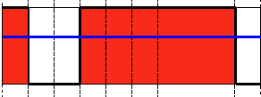
Algorithm: Inverse Binary Threshold
If the intensity of the pixel is higher than threshold, then the new pixel intensity is set to a 0. Otherwise, it is set to max val.
theImage._ThresholdBinaryInv(grayValue threshold, grayValue maxValue)
For comparison: Binary Threshold below

Slide 42
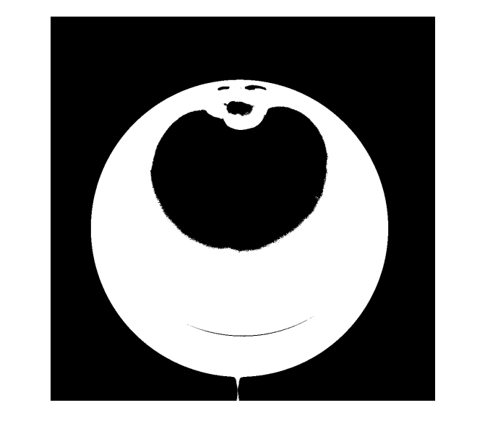
Compare Binary Display & Inverse Binary Display
Inverse Binary display is a matter of visual choice.
theImage._ThresholdBinaryInv(grayValue threshold, grayValue 255)

Slide 43

Compare Inverse Binary Display Thresholds
Threshold = 800
f1 = figure; figure (f1);
target1 = rawData;
target1(target1<800)=255; target1(target1>799)=0;
inverseTarget = mat2gray(target1);
imshow(inverseTarget);
Threshold = 1200
f2 = figure; figure (f2);
target2 = rawData;
target2(target2<1200)=255; target2(target2>1199)=0;
inverseTarget 2= mat2gray(target2);
figure(f2);
imshow(inverseTarget2);

Slide 44
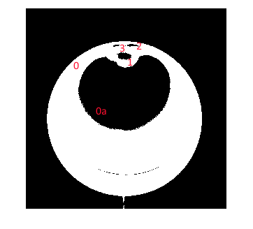
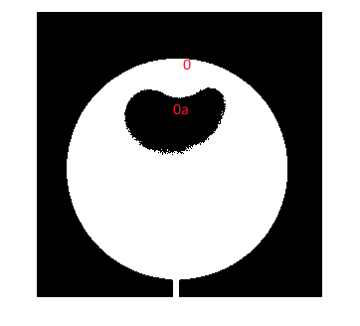
Contours
let contours = theImage._FindContours(
CV_CHAIN_APPROX_NONE,
CV_RETR_EXTERNAL,
roi.Location, listContourPoints)
Chain None: Return all the points in the contour
Retrieve External: Retrieve only the extreme outer contours
Roi is the entire image
listContourPoints: each x,y pixel location where the contour is found

Slide 45
What Constitutes a Good Dataset
Pre-reqs:
  Nominal Circumference of tgt = tgt diameter * 3.1417
  Nominal Area of target = 2 * 3.1417 * (diameter / 2) ^ 2
Must have a contour
Area of contour matches area of target
  let nominalArea = PI*(radius**2.0)
  if (contourArea > nominalArea*1.3 ||
  contourArea < nominalArea*0.7) then failure
Points in contour > nominal circumference * 0.7

Slide 46
Validation Tests Example
Target diameter = 750
Nominal Area = 441786 µ m².
If contour area > 309,250 µ m² and < 574,322 µ m², succeeds.
  Test passes for contour diameter of 626 µ m to 854 µ m
  Range specifier (+/- area * .3) is hard-coded
Circumference = 2356 µ m > #pts in contour * 0.7 (hard-coded)
  Test passes if #pts in contour > 1650.
  Based on microns per pixel, which is approx 1.2 µ m/pxl.

Slide 47
Move Adjustment
Applied to each stage move before sending to plc.
Designed to prevent over-shooting the desired distance.

Slide 48
Summary
Target Rotation provides a 360 degree view of the target
Binary Thresholding clarifies important transition values of interest
Contours are the places where something of interest happens
Choose the contour of interest for further analysis
Validation involves area of contour, number of points in contour
EMGU provides libraries to support thresholding and contour location

